Slide 1



Moisture’s Significant Impact on Twisted Polymer Actuation
Diego R. Higueras-Ruiz, Ph.D. Student
Dr. Heidi P. Feigenbaum, Associate Professor
Dr. Michael W. Shafer, Assistant Professor

Slide 2
Outline:
Introduction to Twisted Polymer Actuators
Mechanics of Actuation
Microstructure of the precursor monofilament
Principle of thermal actuation
Principle of hygroscopic actuation
Moisture Absorption and Desiccation Behavior
Moisture Effects on Thermal Actuation
Axial Thermal Contraction and Elastic Modulus
Moisture Content Effects on STPAs and TCPAs
Hygroscopic Actuation
Conclusions

Slide 3
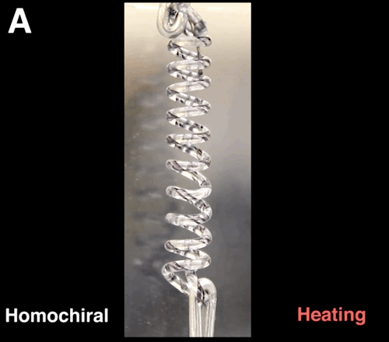
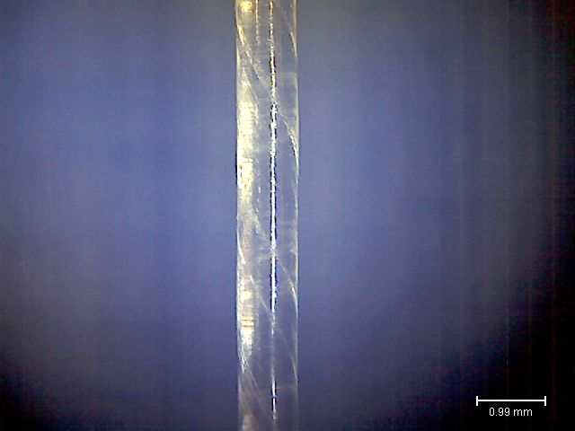
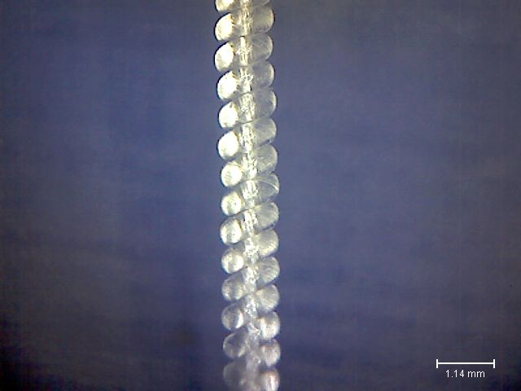
Introduction to Twisted Polymer Actuators
Inexpensive active material
Thermally driven
Develop forces a hundred times stronger that can human muscle of same length and weight [Haines et al.]
They can contract about 50% [Haines et al.]
High specific work (2.48 kJ/kg), [ Haines et al.]
Linear and torsional actuation
Charles Q. Choi
0.99 mm
1.14 mm
Straight twisted polymer actuator (STPA)
Twisted coiled polymer actuator (TCPA)

Slide 4

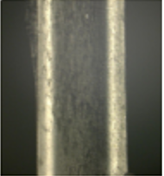

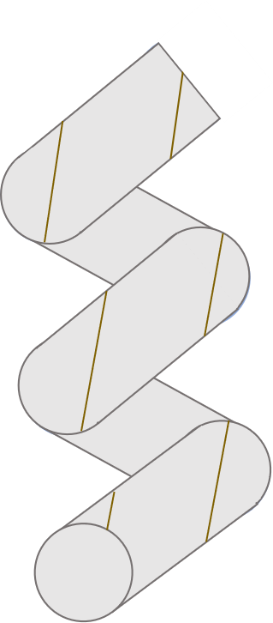
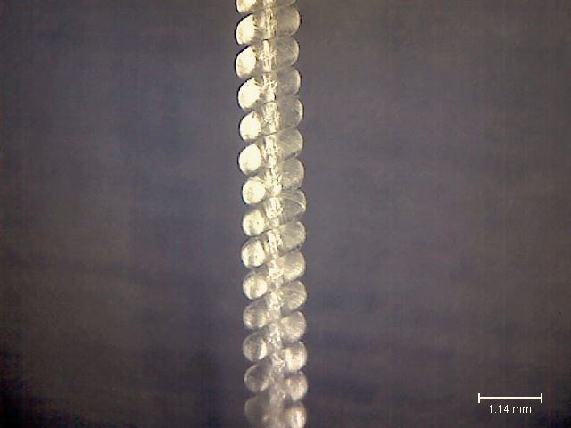
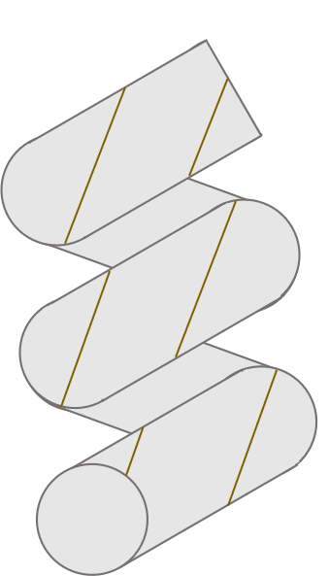
Microstructure. Thermal Actuation
Thermal Actuation
Heated drawn polymer monofilament expands radially and contract axially
ΔT
Untwisted Monofilament
Interfibrillar
tie chains
High stiffness internal fibers helically orientated cause shear deformation
ΔT
Crystallite
Straight-twisted polymer actuator (STPA)
Torsion
Amorphous
The thermal torsional response of STPA translates to contraction of TCPA.
ΔT
Contraction
Twisted-coiled Polymer Actuator (TCPA)
Microfibrillar

Slide 5
Microstructure. Hygroscopic Actuation
Hygroscopic Actuation
Bounded H₂O molecules cause high radial and low axial expansion by swelling
ΔM (%)
Untwisted Monofilament
Bounded H₂O molecules cause untwist due to the new twisted fiber orientation
Unbonded
H₂O molecules
(free volume)
ΔM (%)
Straight-twisted polymer actuator (STPA)
Torsion
Bonded
H₂O molecules
(polymeric matrix)
Torsional response of STPA translates to contraction of TCPA due to the swelling in the material
Voids
ΔM (%)
Contraction
Twisted-coiled Polymer Actuator (TCPA)

Slide 6
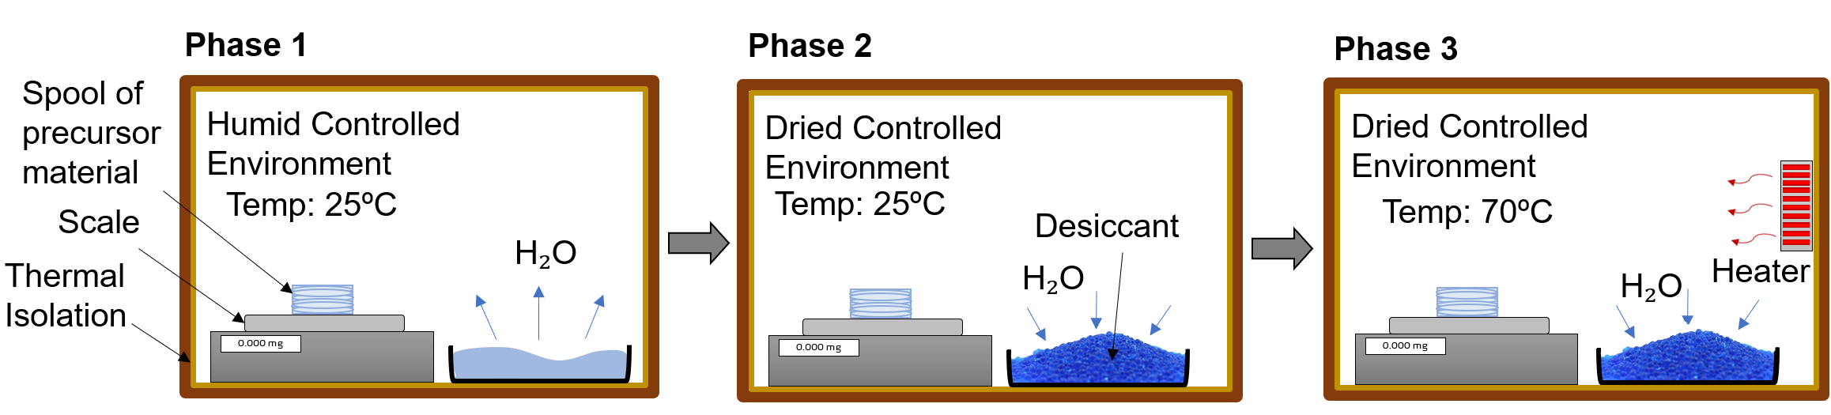
Moisture Absorption and Desiccation Behavior

Slide 7
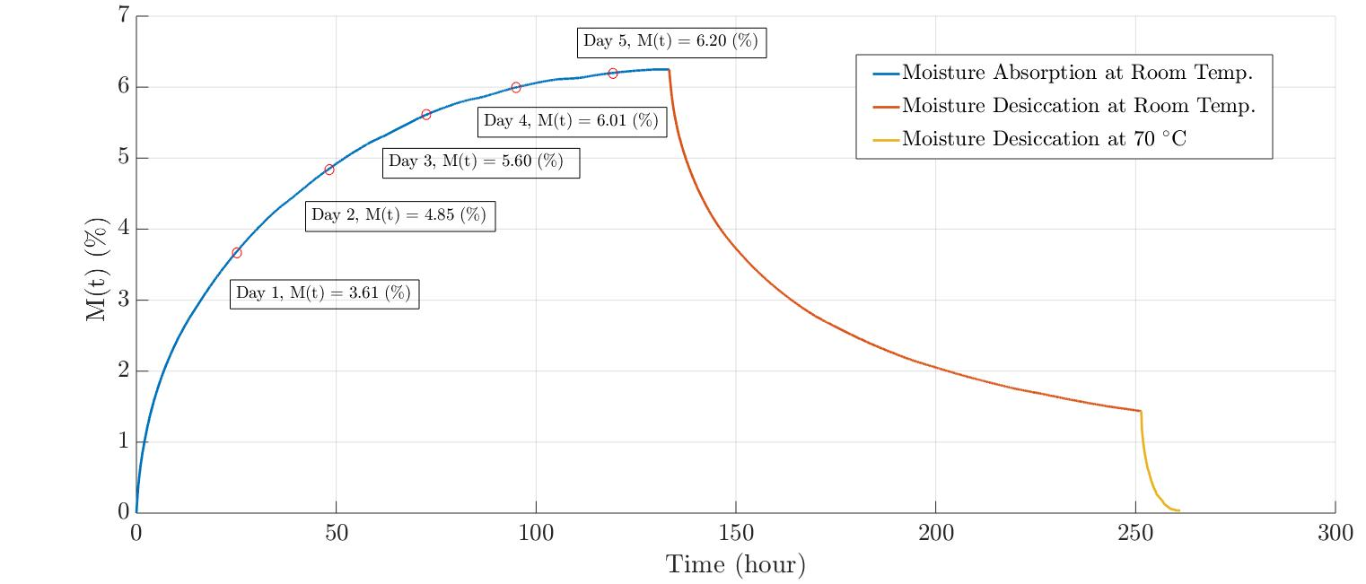
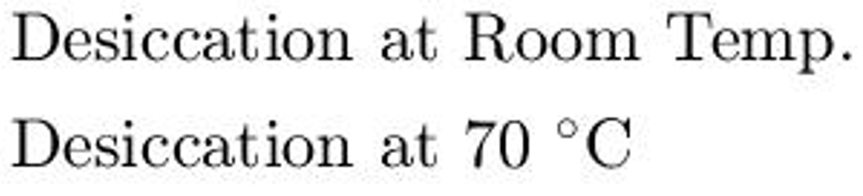
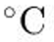
Moisture Absorption and Desiccation Behavior
Fast
Absorption
Response

Slide 8
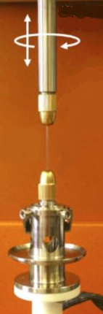










Axial Thermal Contraction and Elastic Modulus
Sample
Bi-directional Motion
Rheometer
Heat Gun
Manual
Temperature
Control
Sample
Monofilament Clamps
Thermal Camera
Laser Vibrometer
Temperature signal
Displacement signal

Slide 9
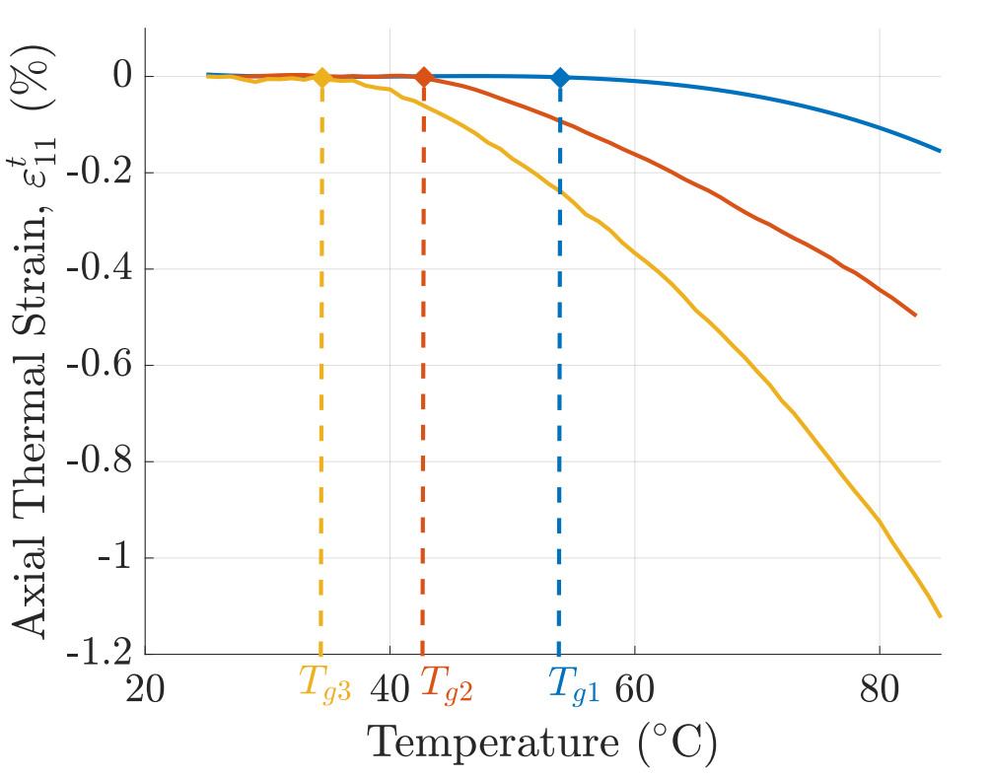
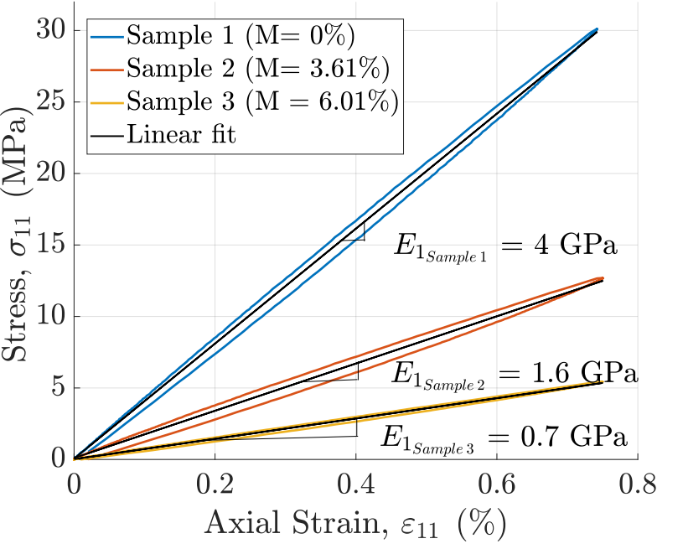

Slide 10
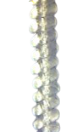
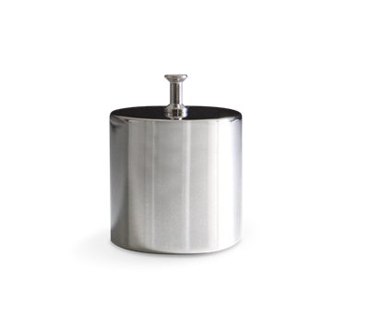
Moisture Content Effects on STPAs and TCPAs
TCPA
Laser Vibrometer
Thermal Camera
Torque Spool (6mm dia.)
Heat Gun
Manual
Temperature
Control
Bearing
Thermal Camera
Collet
STPA
Load
Temperature signal
Heat Gun
Laser Vibrometer
Frame
Displacement signal
Weight 1

Slide 11
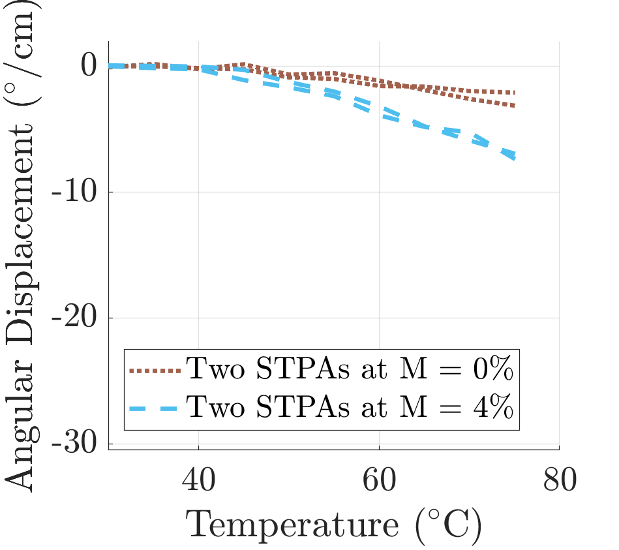
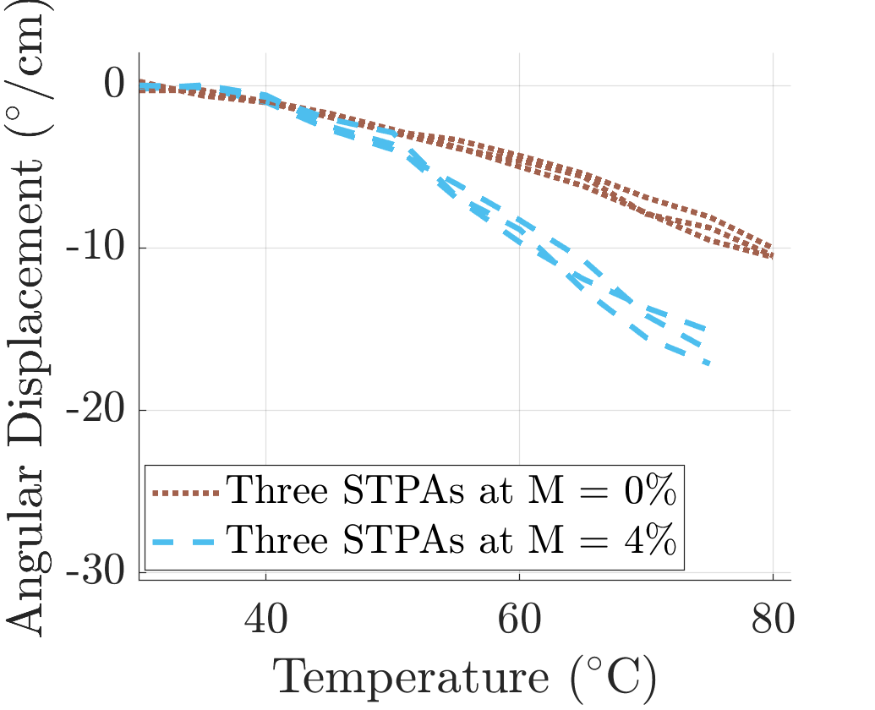
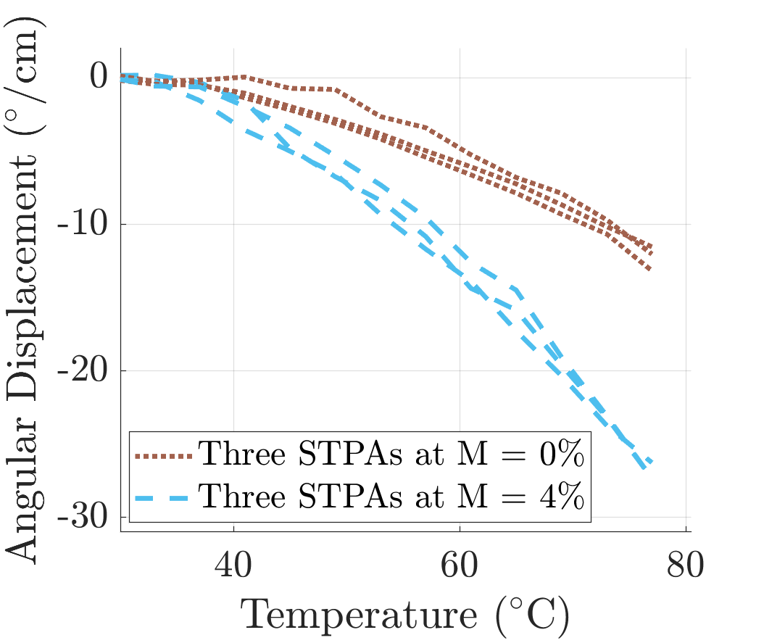
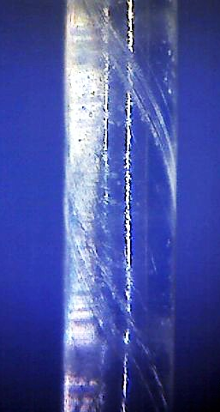
Moisture Content Effects on STPAs and TCPAs

Slide 12
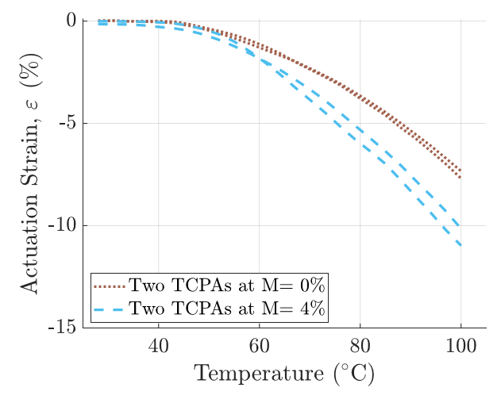
Moisture Content Effects on STPAs and TCPAs

Slide 13
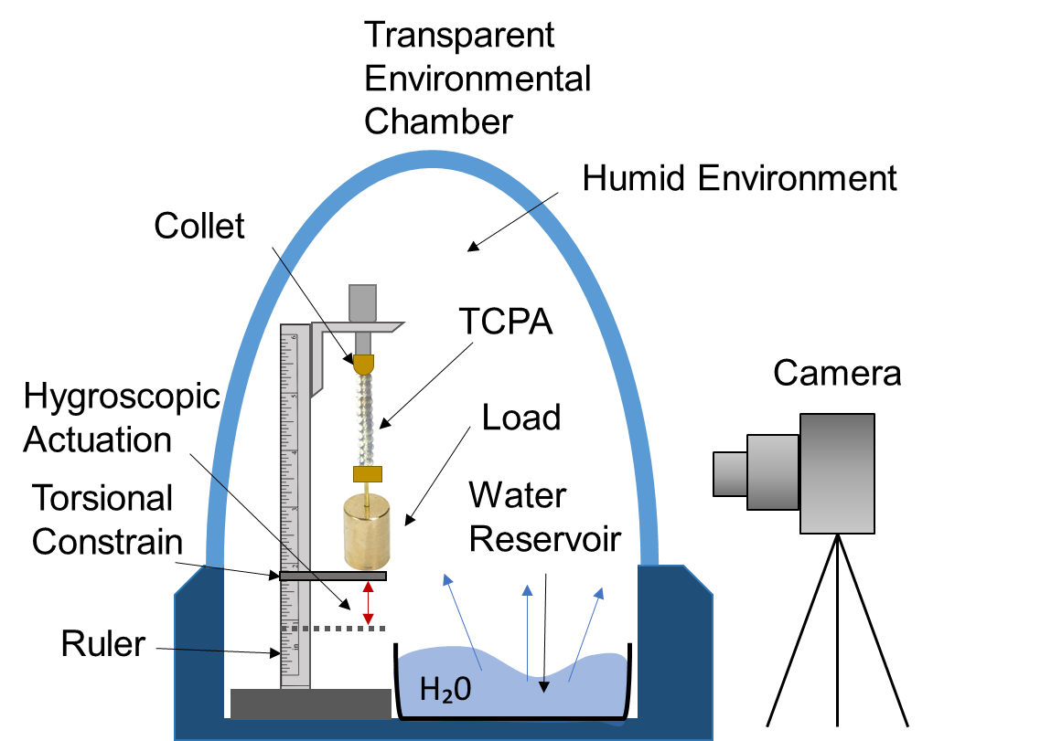
Hygroscopic Actuation
Camera
Actuation
Indicator Flag
Transparent Environmental Chamber
Humid Environment
H₂0
STPA
Water Reservoir
Collet
Hygroscopic Actuation

Slide 14
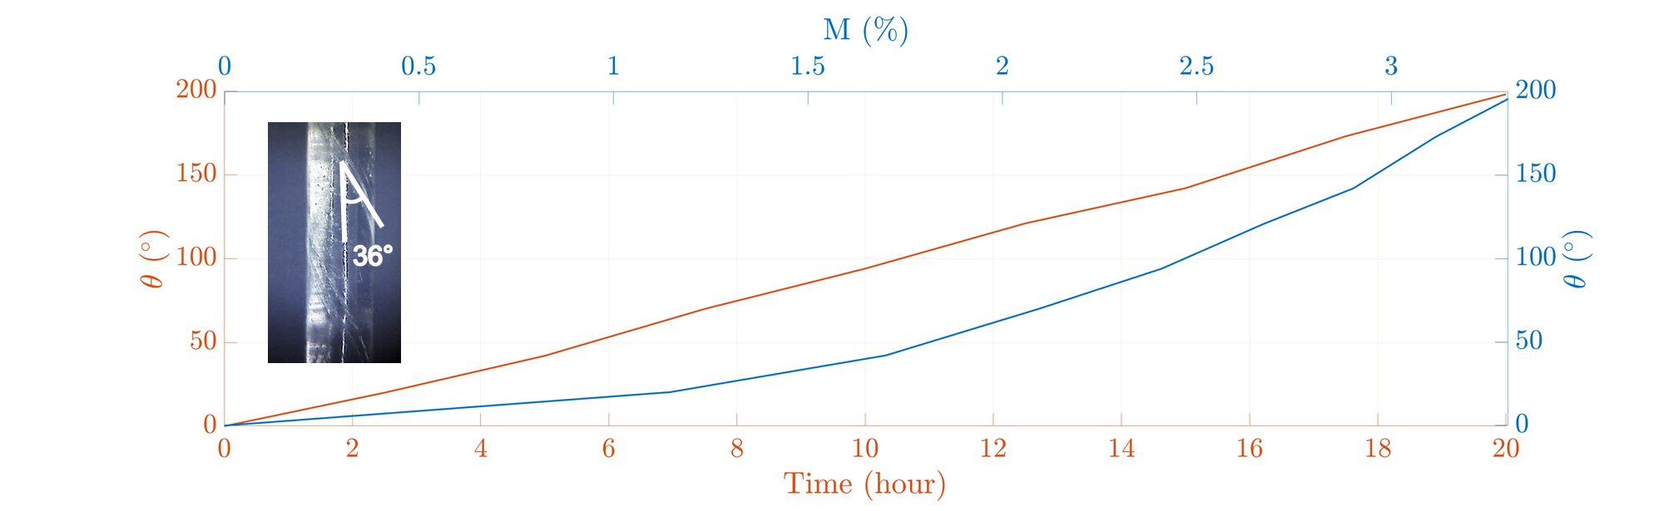
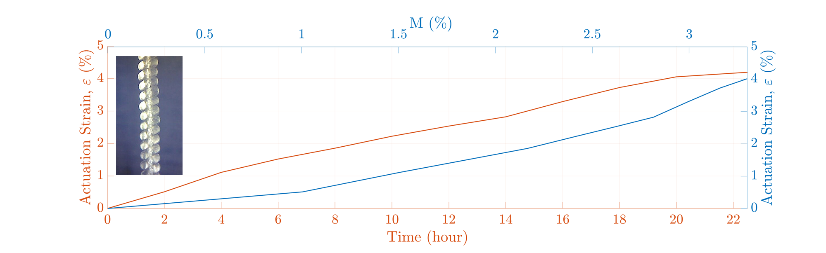
Hygroscopic Actuation

